Slide 1

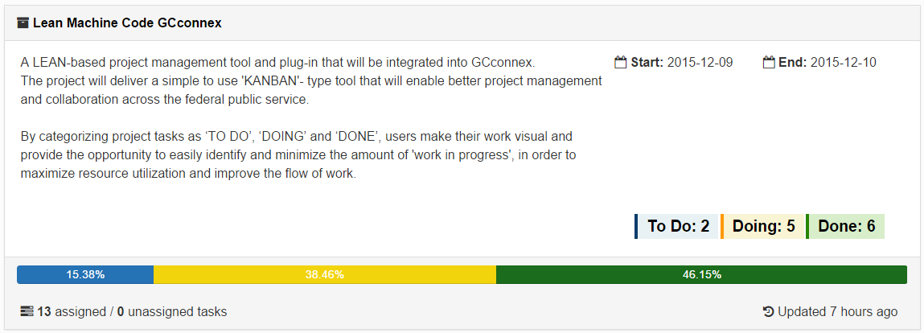
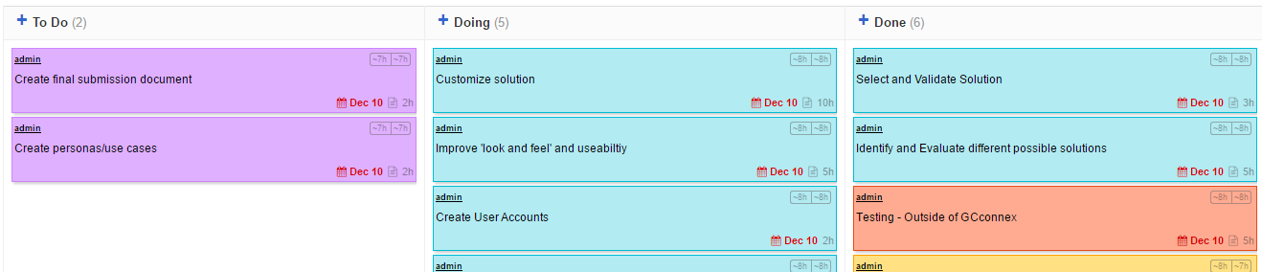
Lean Machine
The ‘Open Source’ Product
#CodeGCconnex
This tool will facilitate communication and collaboration in project management across the government of Canada by providing increased visibility to the current status of projects and related tasks. By making work more visible, team members can easily identify backlog and opportunities for improvement.
The Lean Machine app provides a simple-to-use project management tool that will enable Government of Canada employees to better manage and collaborate on their projects and related tasks.
The tool is based on the principles of ‘LEAN Management’ and utilizes an automated KANBAN board which makes work more visible. By making required, ongoing, and completed work more visible, users can better manage and monitor the progress of their projects. The tool also provides a resource/time tracking feature.
The Team
Ali Al-Munayer CSC Lead Developer | Sushanth Sankaran PSPC Tester/Developer/Non-GCconnex User | Adrianne Lee Service Can UX designer
Terry Kelly TBS Communications and GCconnex expert | Eugene Omboli PSPC Strategic thinker and project manager
Rima Sakr TBS GCconnex and Project Management expert | Shantia Thompson CSC Project Management Expert
Collaboration is critical to successfully reconcile diverse skills to design and develop a lean-based approach to project management.
Github
https://github.com/3lywa/gcconnex.git
Demo (sushi/adminguy)
http://www.3lywa.com/gcc/

Slide 2
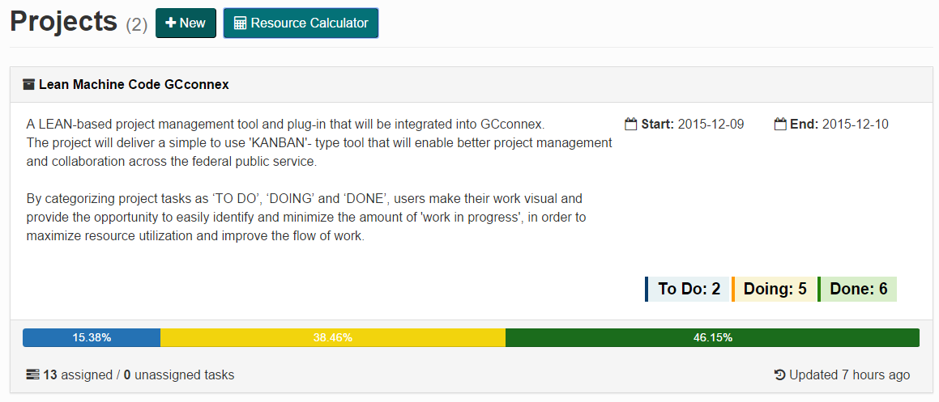
Lean Machine
GCconnex Plug-In

Slide 3

Lean Machine
Kanboard Solution

Slide 4
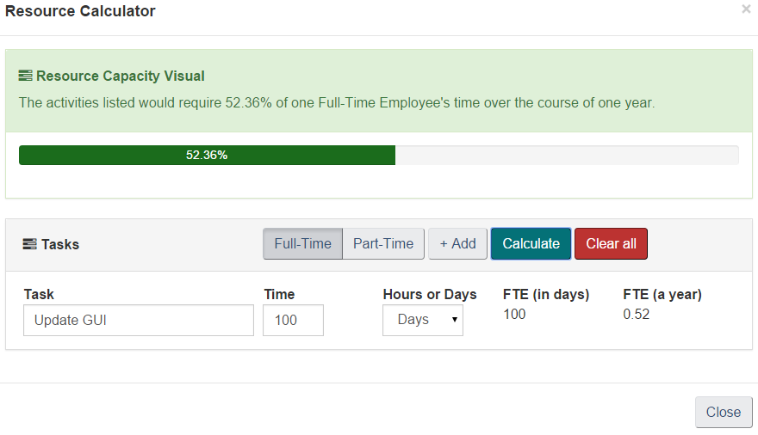
Lean Machine
Resource Calculator

Slide 5
Lean Machine
Persona
Scott is a 35 year-old Male, with a nice beard and orange tie.
He is working on assignment in a new department in a new role as a project officer. He has been asked to manage 3 medium sized projects – ranging from 6-12 months in length and reporting directly to the Director, on a monthly basis.
He is excited to learn his team has embraced GCconnex and quickly becomes colleagues with all of them, including those that he needs to collaborate with on projects.
He is also excited to learn he is in a fresh Blueprint 2020 environment where he has some discretion over how he will report on and manage his projects.
Scott is pretty good at project management, but given the higher level of collaboration with these projects, he feels like he needs a framework or solution to manage reporting and track progress.
He researches project management courses and solutions and finds there is a 3 day course on project management in 2 months and a course on micro-soft project next month. He is ambivalent about micro-soft project because he has heard staff grumbling about the functionality and complexity. He also doesn’t have time to learn new software as project management activities have commenced upon his arrival and he needs to assign tasks to project team members.
Scott is comfortable with technology and uses agile and simple apps to plan trips and manage the family budget – he actually enjoys that experience. He notices that the team Lean Machine won Code GCconnex and has been following their project with great interest. He uses the Kanban project management feature within GCconnex to assigned to create projects and assign tasks to his colleagues.
Scott is able to use the tool to track progress produce reports for his team and bilat meetings with the Director. He finishes all of his projects on time and goes from an AS5 position to an EX1 in two years, because of his new found success in the realm of project management.

